Slide 1
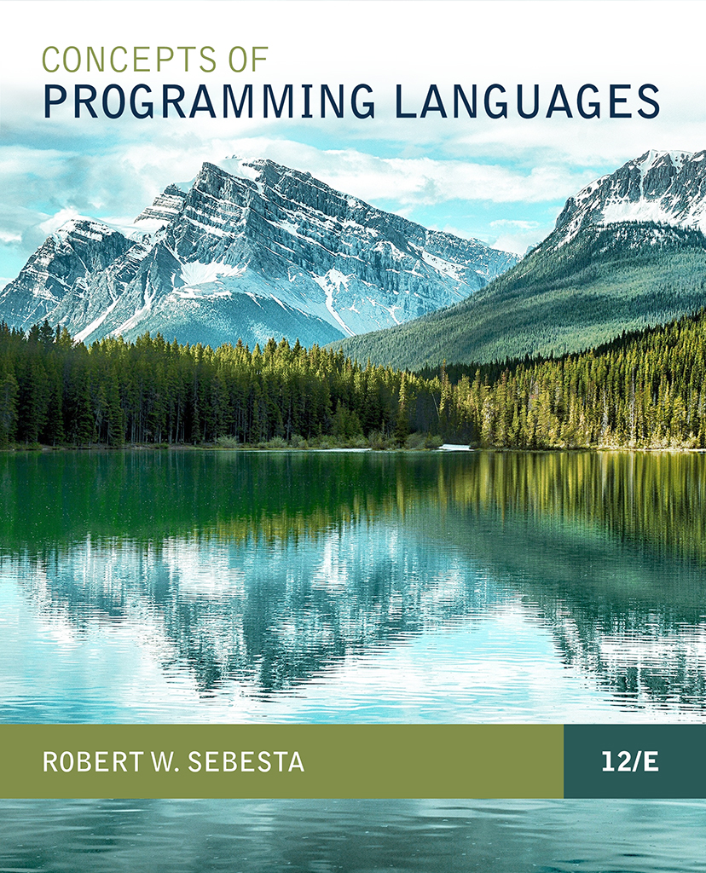
CONCEPTS OF PROGRAMMING LANGUAGES
12th Edition
Chapter 3
Describing Syntax
and Semantics

Slide 2
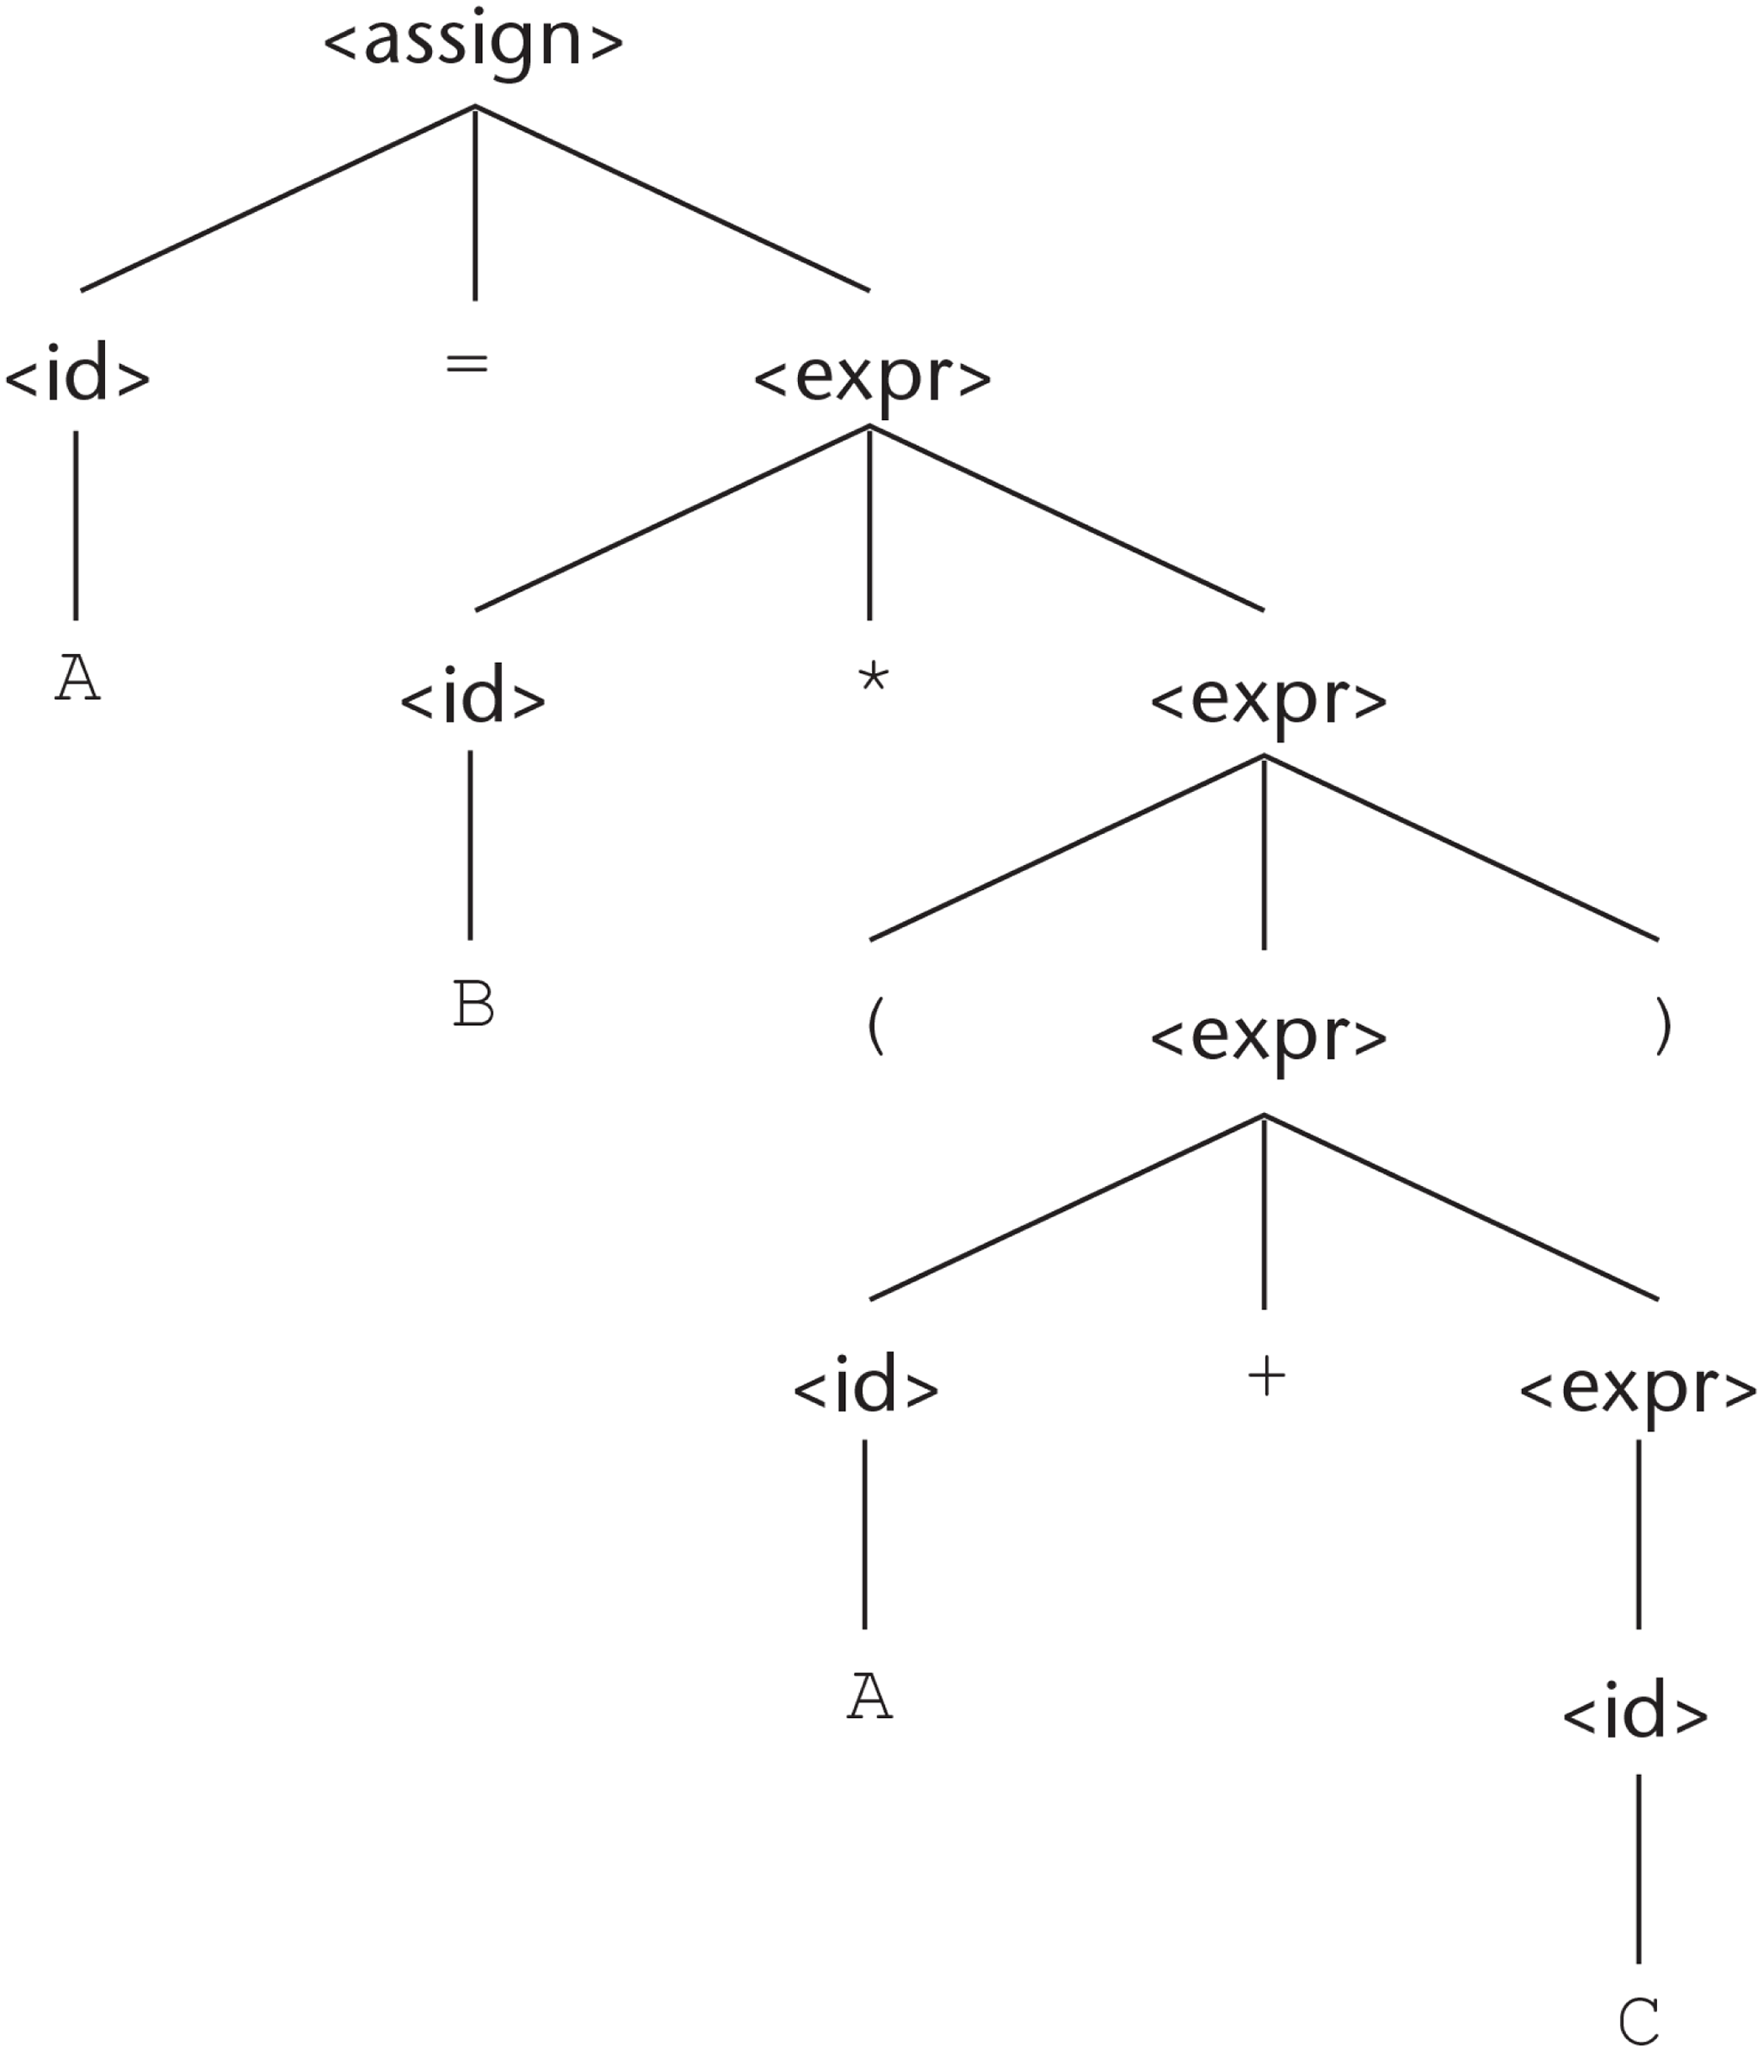
Figure 3-1 A parse tree for the simple statement A = B * (A + C)

Slide 3
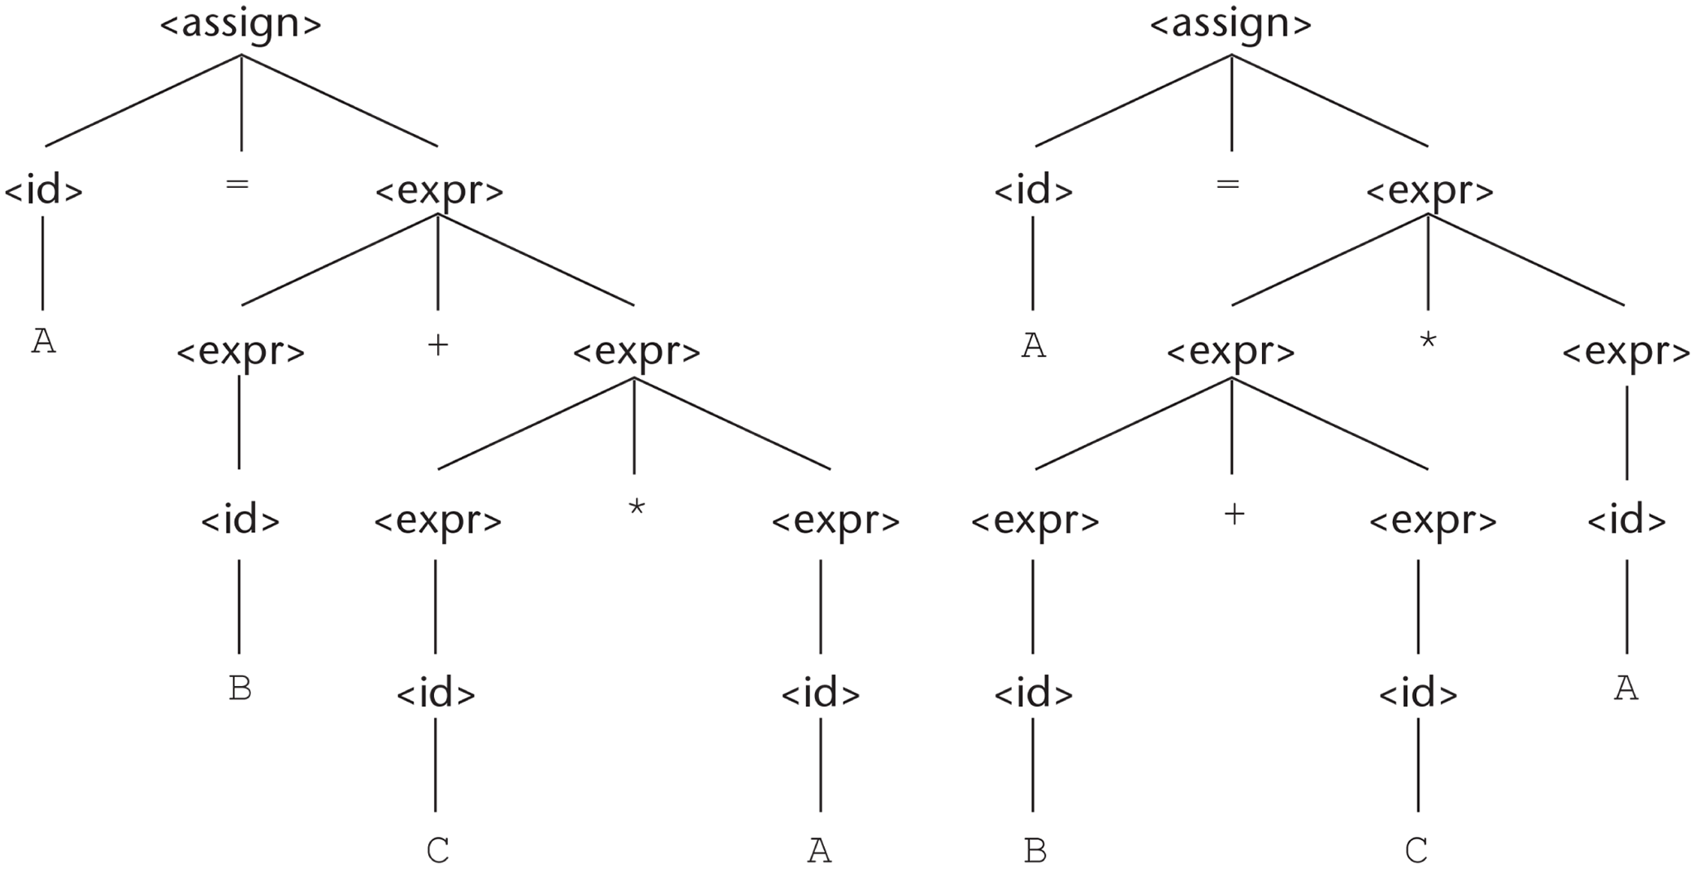
Figure 3-2 Two distinct parse trees for the same sentence, A = B + C * A

Slide 4
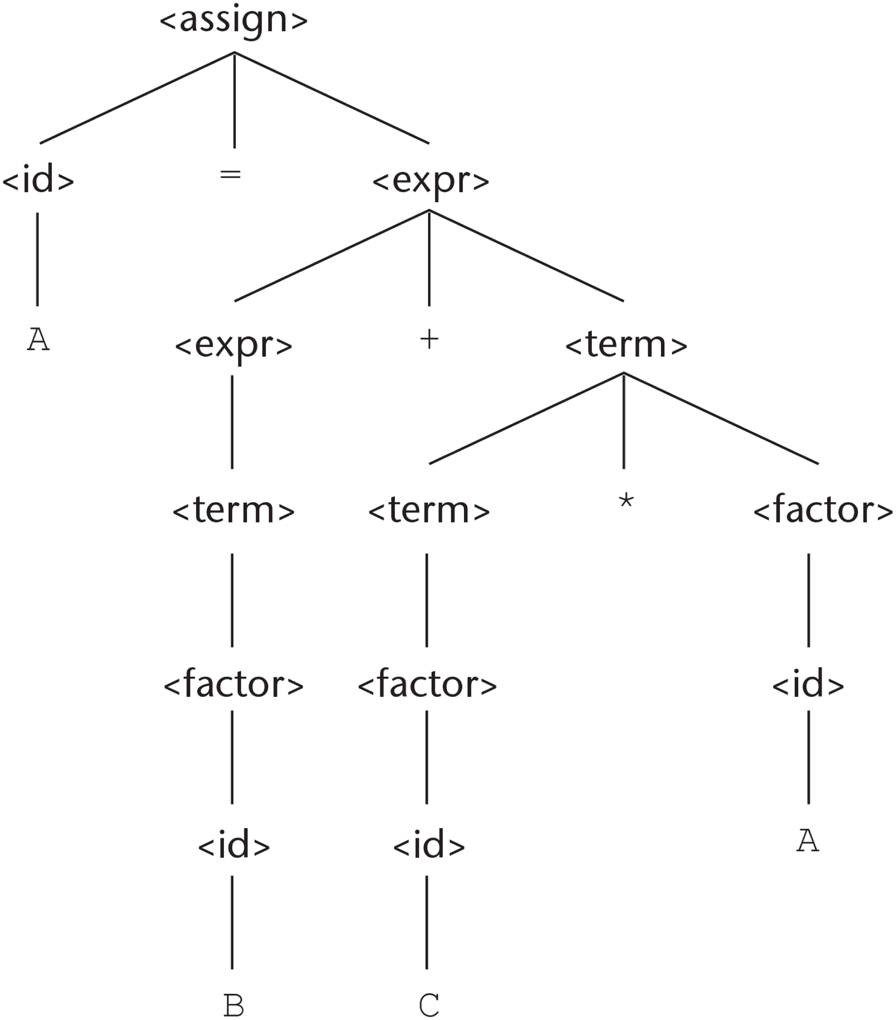
Figure 3-3 The unique parse tree for A = B + C * A using an unambiguous grammar

Slide 5
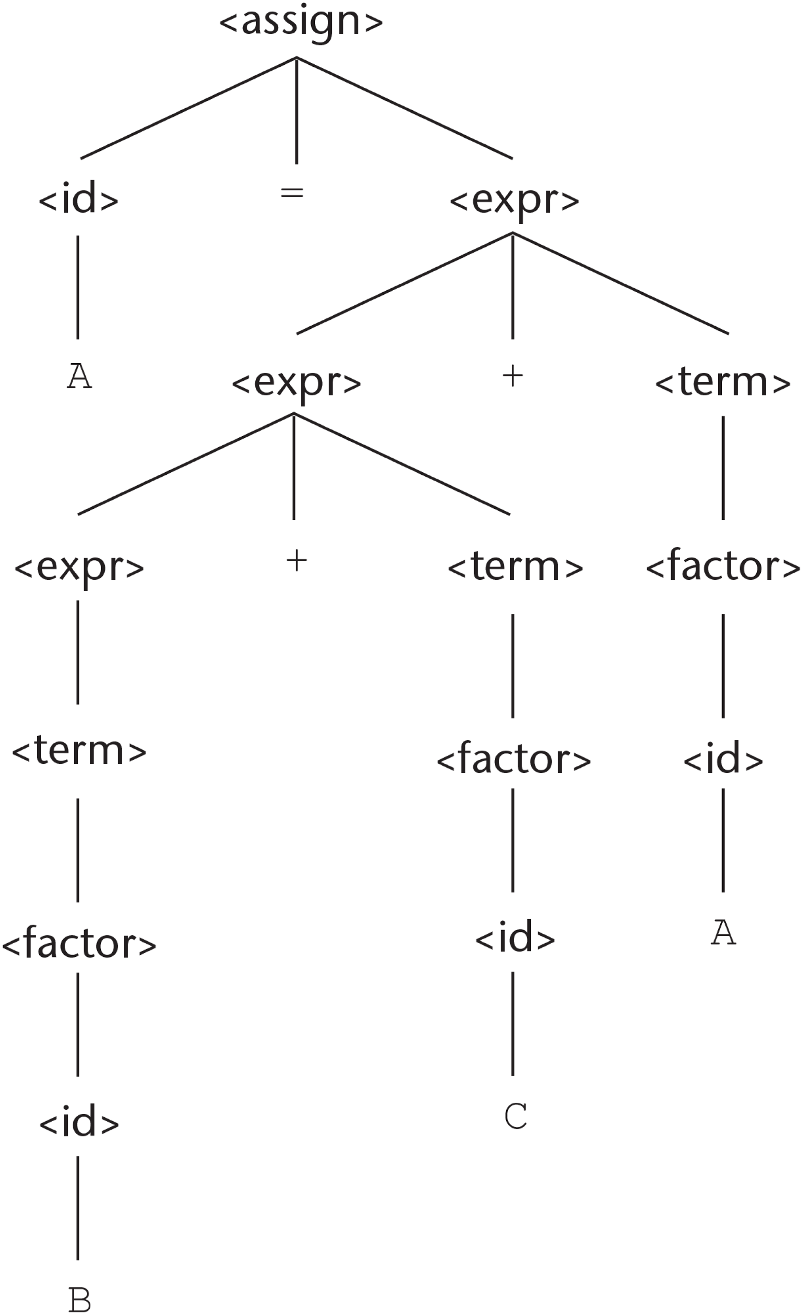
Figure 3-4 A parse tree for A = B + C + A illustrating the associativity of addition

Slide 6
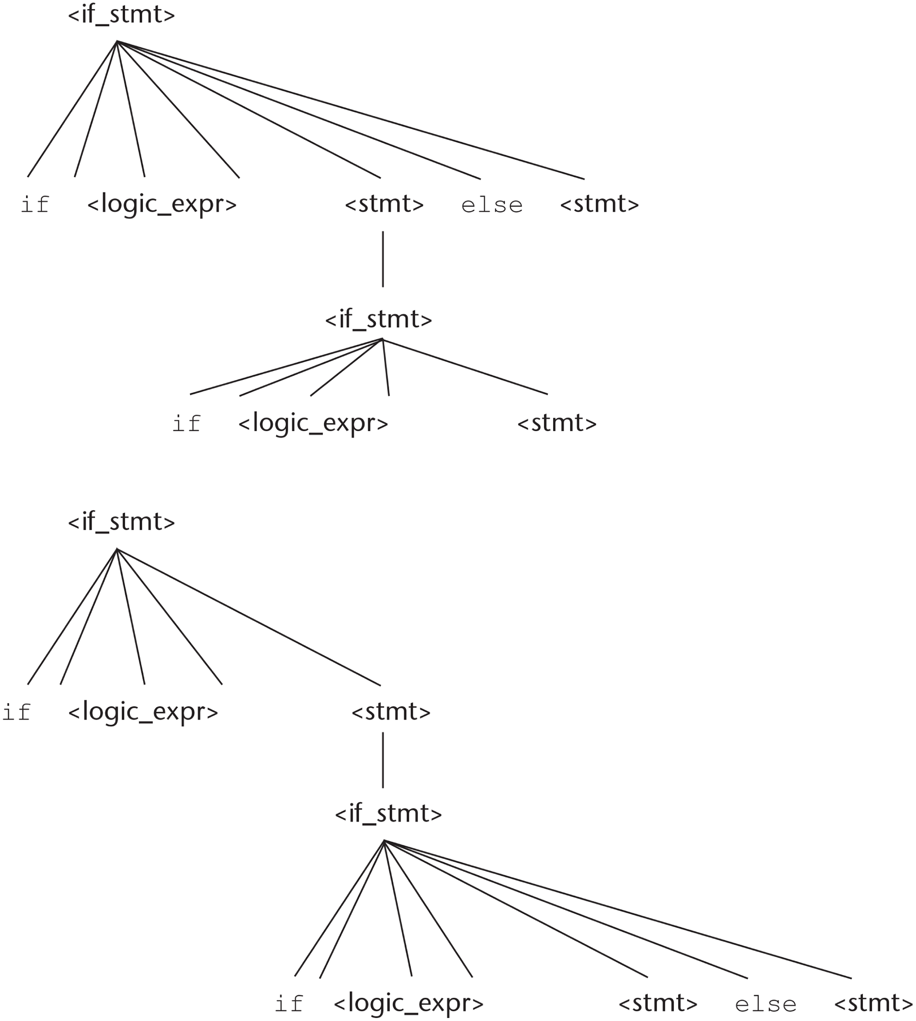
Figure 3-5 Two distinct parse trees for the same sentential form

Slide 7
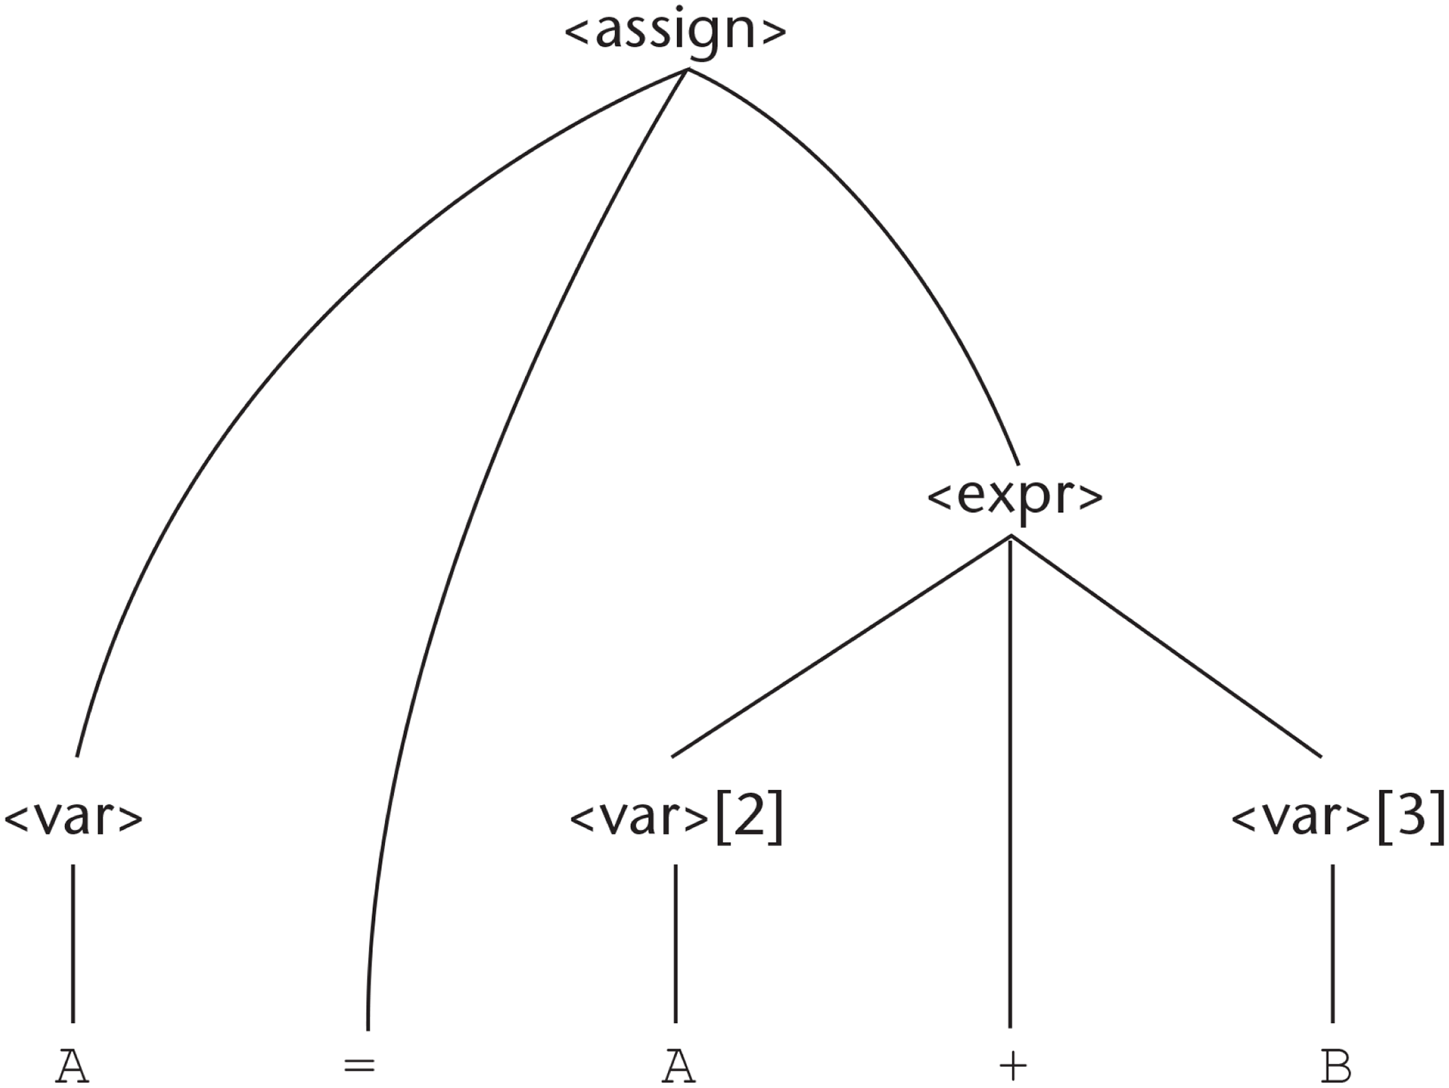
Figure 3-6 A parse tree for A = A + B

Slide 8
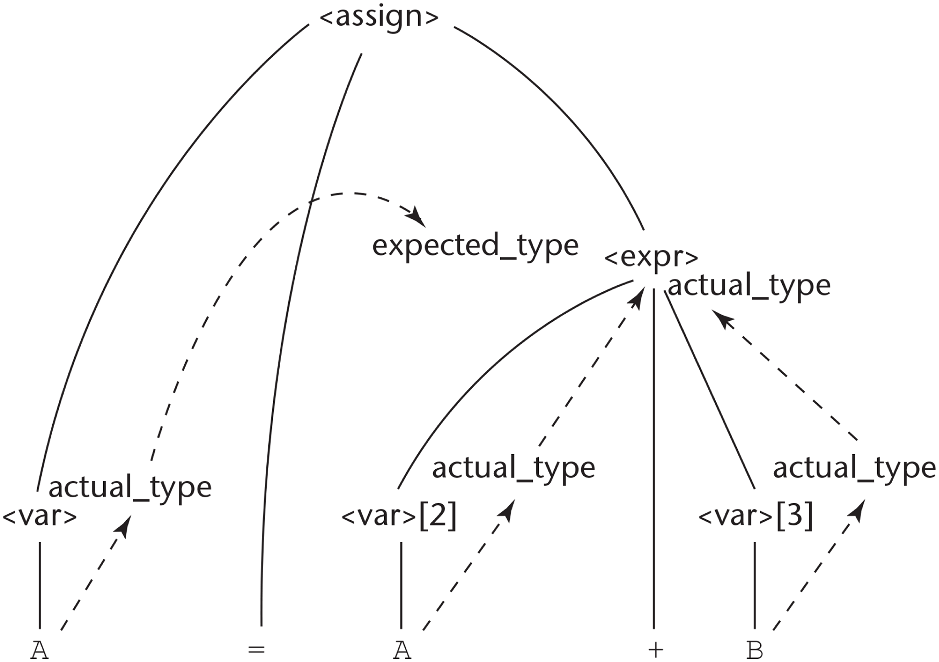
Figure 3-7 The flow of attributes in the tree

Slide 9
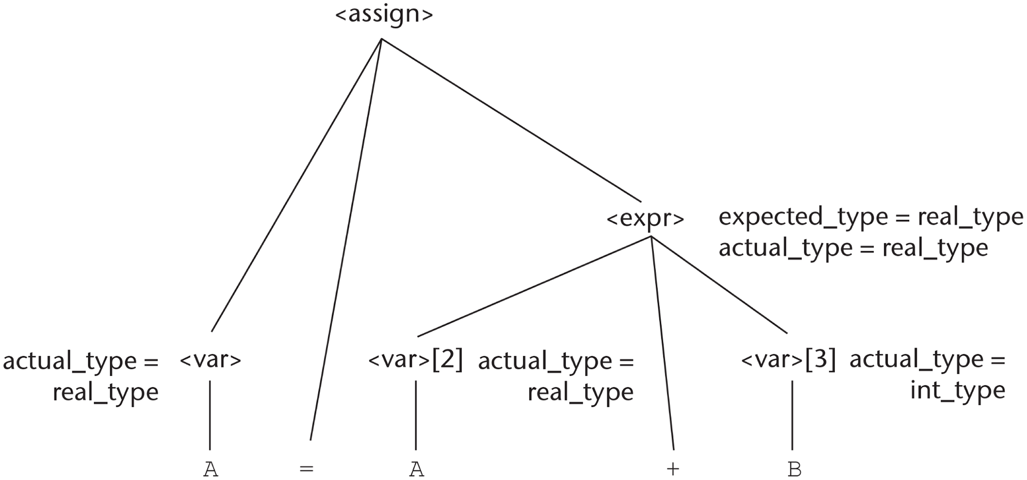
Figure 3-8 A fully attributed parse tree

Slide 10
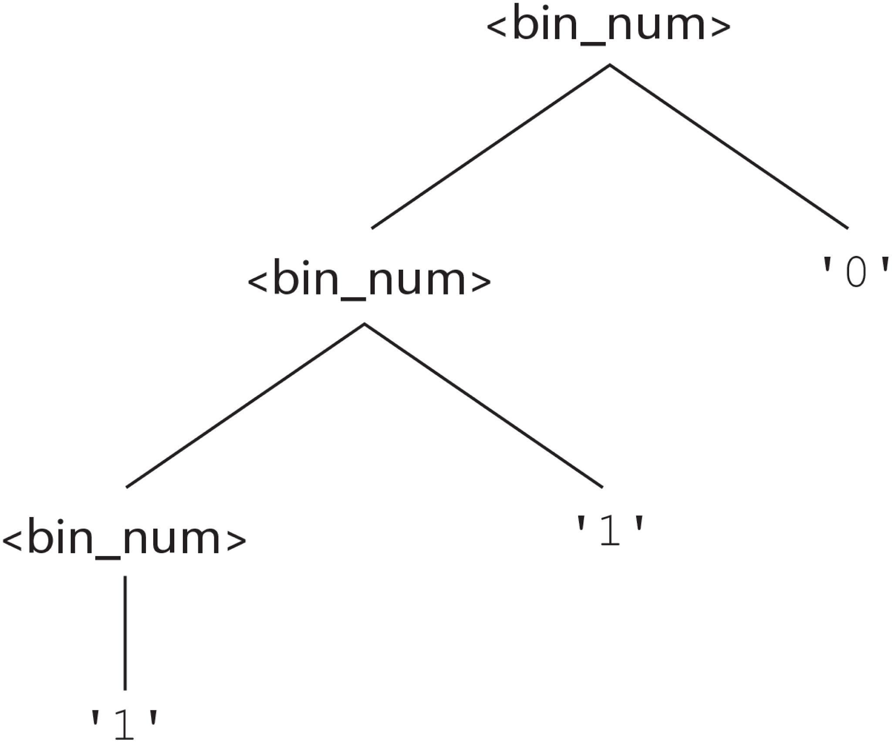
Figure 3-9 A parse tree of the binary number 110

Slide 11
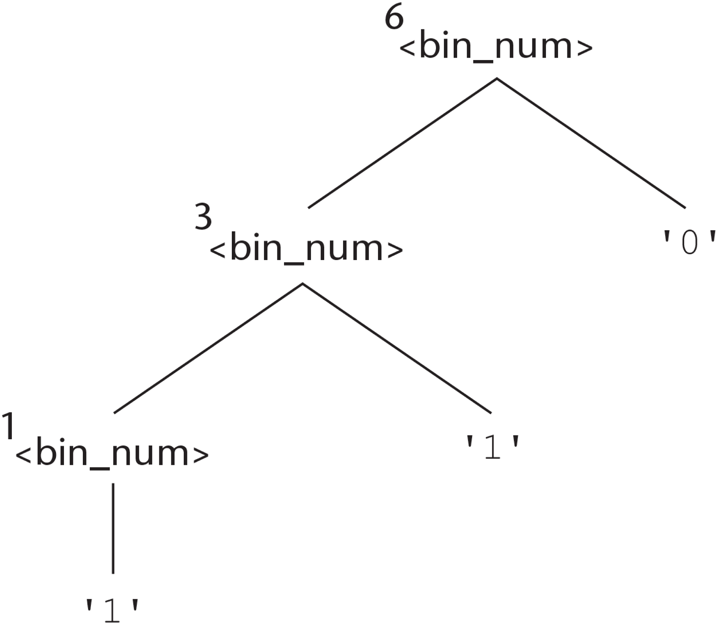
Figure 3-10 A parse tree with denoted objects for 110

